Slide 1




Climate testimonies: a educational project for recovering the climatic memory
Dr. Jordi Mazon
Jordi.mazon@upc.edu

Slide 2
Weather has changed, and it is changing …. This is an evidence:
Acording to the 5th IPCC report (IPCC, 2013, 2014)
Warming of the climate system is unequivocal, and since the 1950s, many of the observed changes are unprecedented over decades to millennia
Atmospheric concentrations of Carbone dioxide, methane, and nitrous oxide have increased to levels unprecedented in at least the last 800,000 years
Human influence on the climate system is clear. It is extremely likely (95-100% probability) that human influence was the dominant cause of global warming between 1951-2010
Different tools have used by scientist to study how climate has changed ….. Such as ….

Slide 3
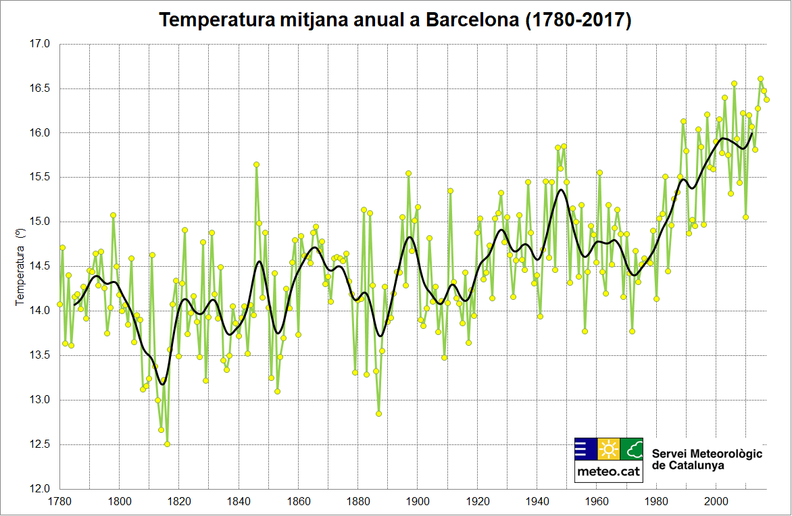
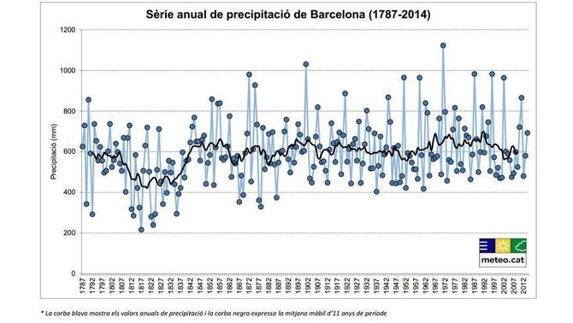
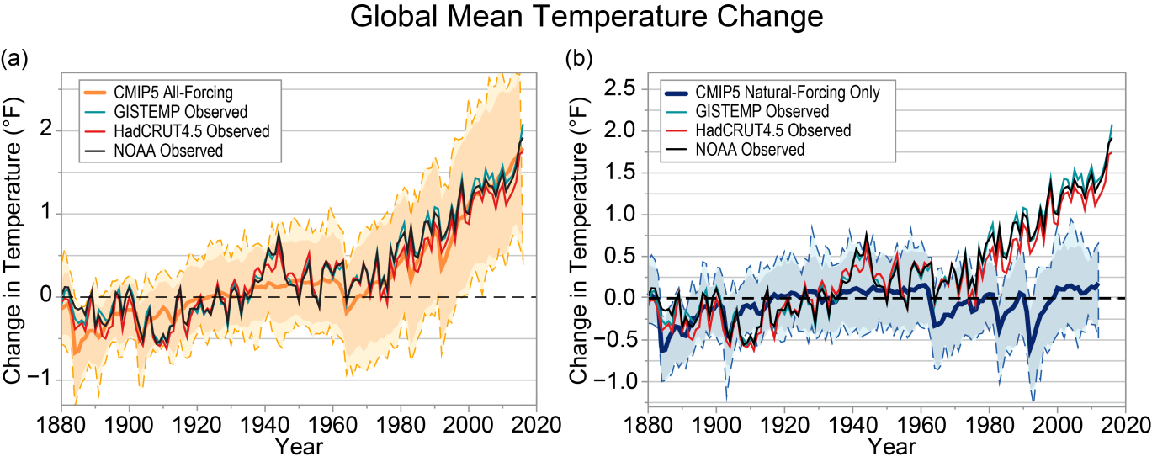
a/ Instrumental data (e.g. Temperature, Precipitation, …) measured from weather stations …
MeteoCat
b/ numerical model simulations….
IPCC

Slide 4
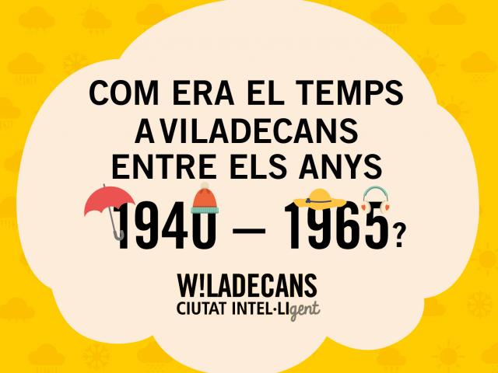
There are large value non-instrumental data for studying
how the climate has changed:
Memories and experiences of old people about weather in the past
We are looking for young people in the period 1940-65 (old people nowadays) to explain us how their customs and society have changed as a consequence of climate change
We name this people as
Testimonies of climate
How weather was in Viladecans between 1940-1965?

Slide 5
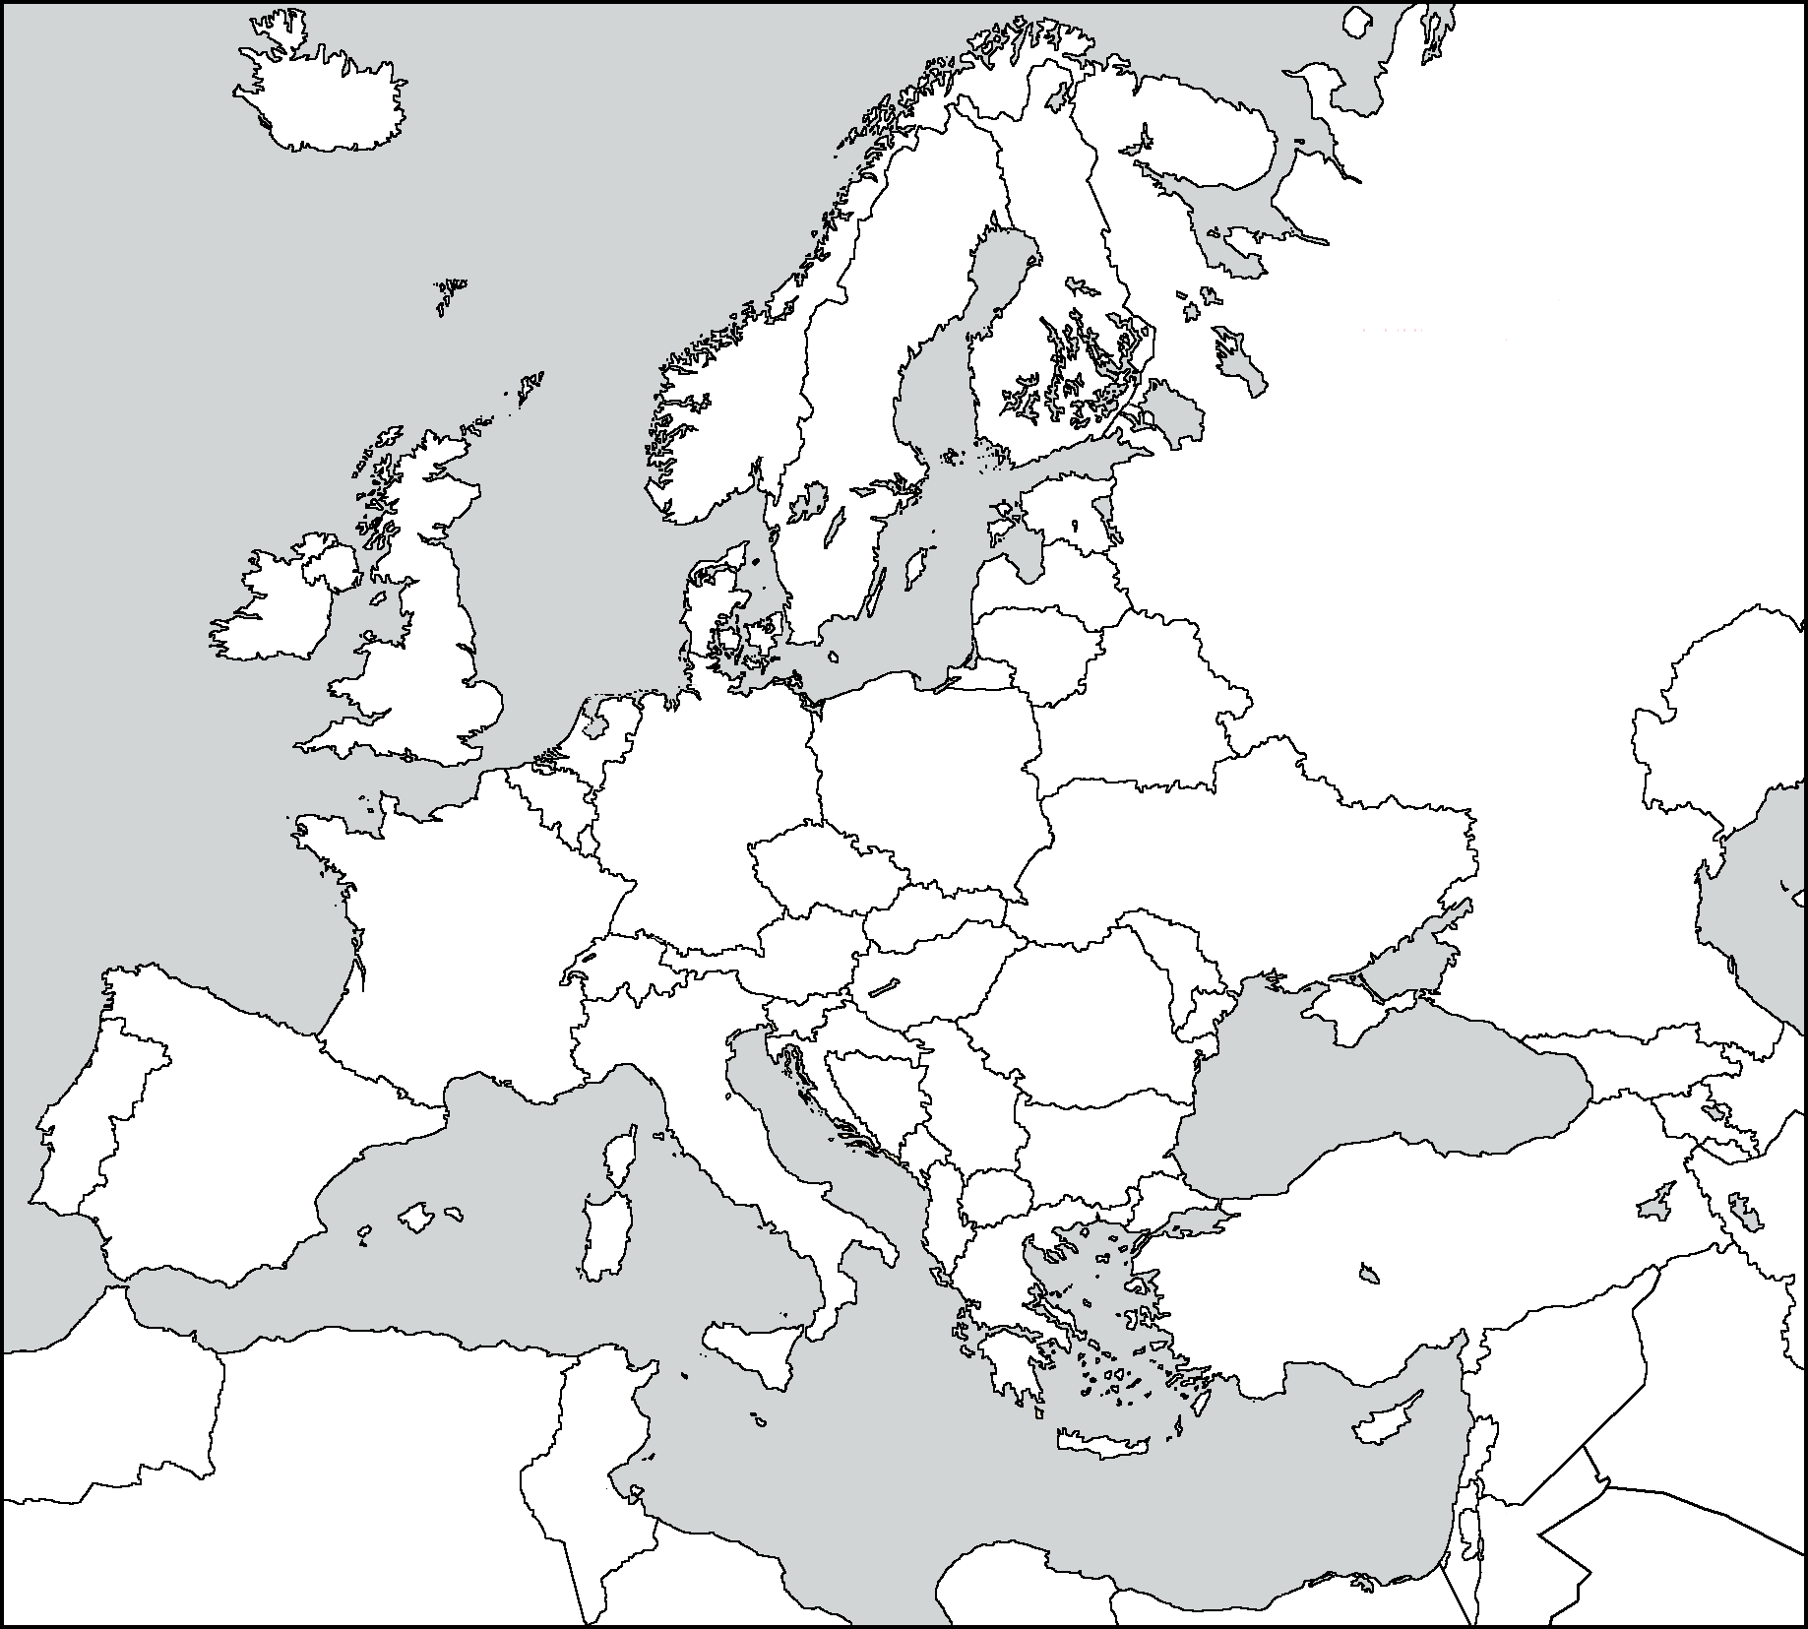
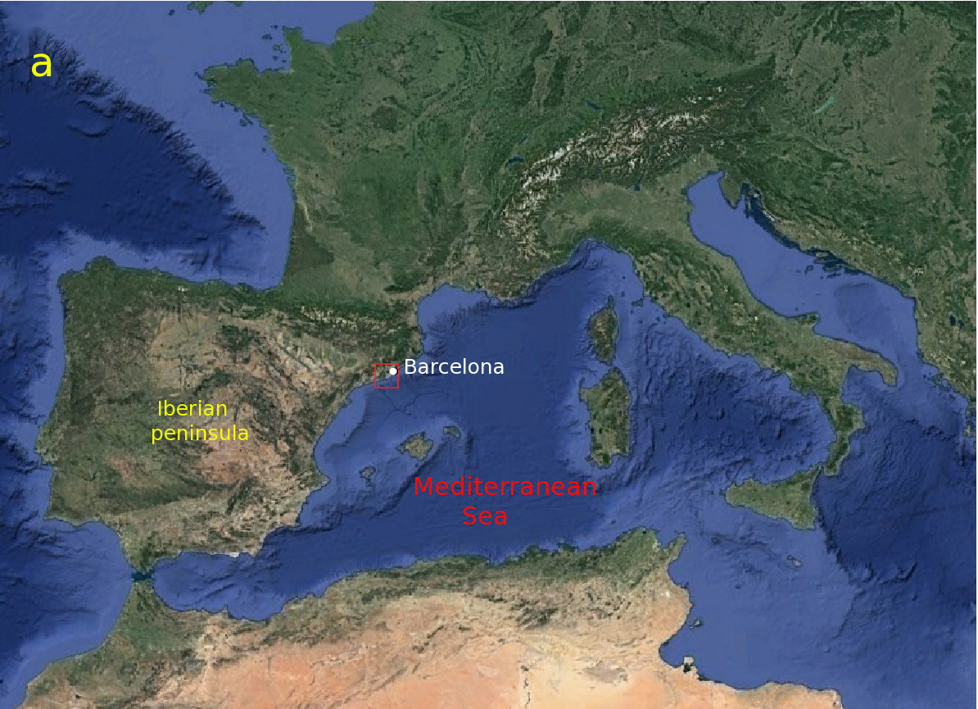
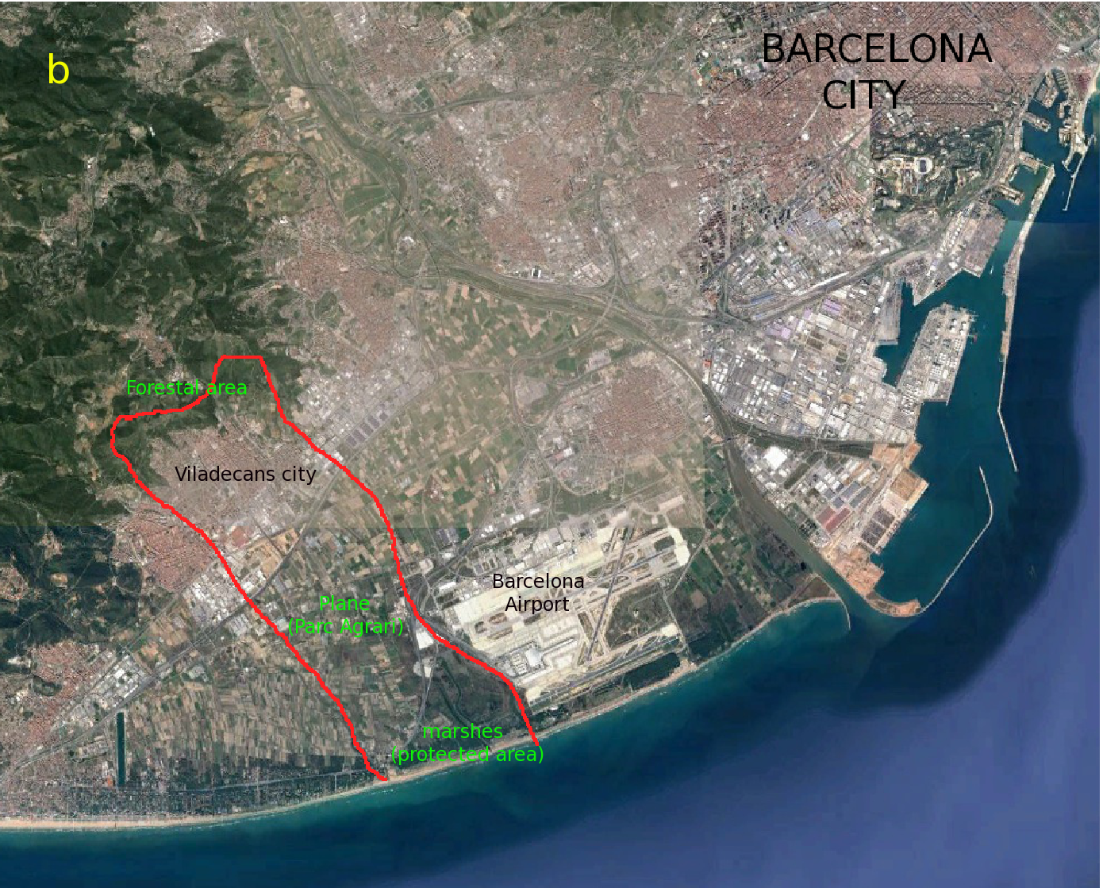
Where is Viladecans located?
BARCELONA

Slide 6
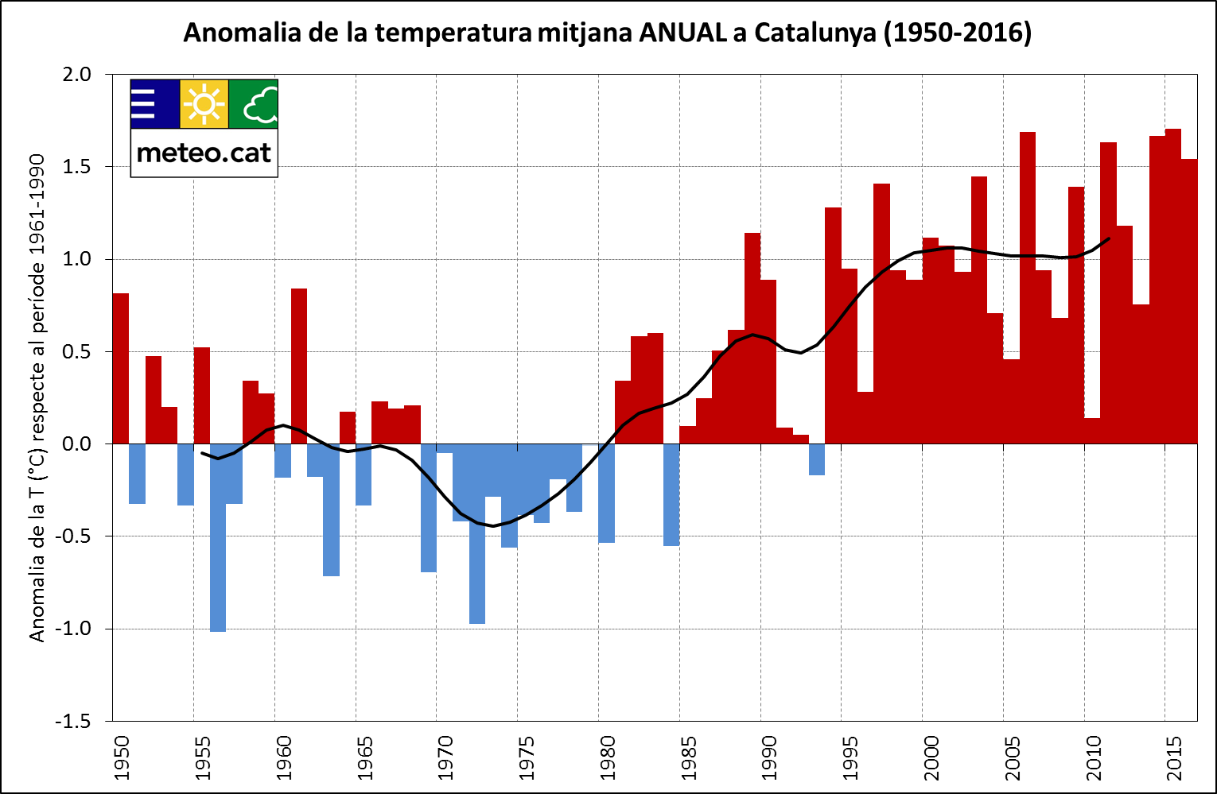
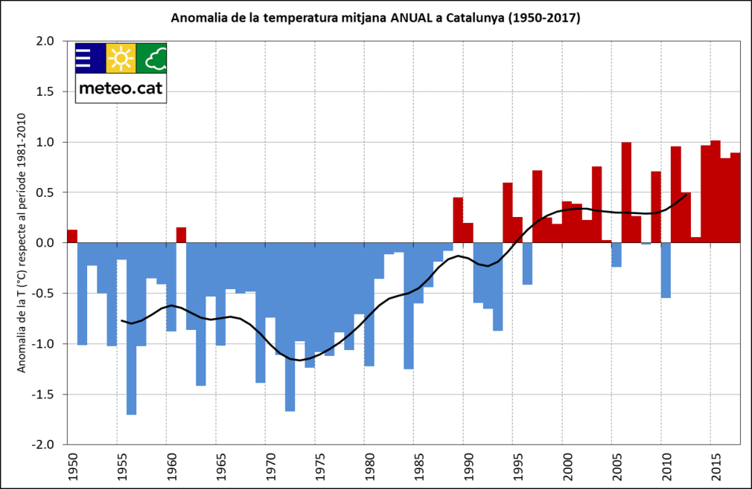
Why this period?
The period 1940-1965:
- According to IPCC (2014) 1951 anthropogenic warming starts to be rellevant.
Previous to the large signal of climate change
There are old people remembering weather during this period (aged >75)
This is an opportunity (the last generation before the great change in the
tendency in weather) to recover its memories.

Slide 7
The goal of this project :
To recover memories of old people about past weather in order to understand better how the climate has changed since 1940 until now.
To recover and use complementary data to the instrumental one and numerical models for studying climate change, and so to take another approach of social changes due to climate change.
To create a audiovisual doc summarizing these memories (such as it is common to recovering memories about the Civil War, World War II, etc…)
To develop a educational project (for elementary school) involving older and younger citizens.

Slide 8
Methodology
Call for testimonies
5 had been selected for the video
Record the video
A survey is performed in all elderly people's home
Extract data from testimonies
Educational project for elementary schools
In progress (2019)

Slide 10
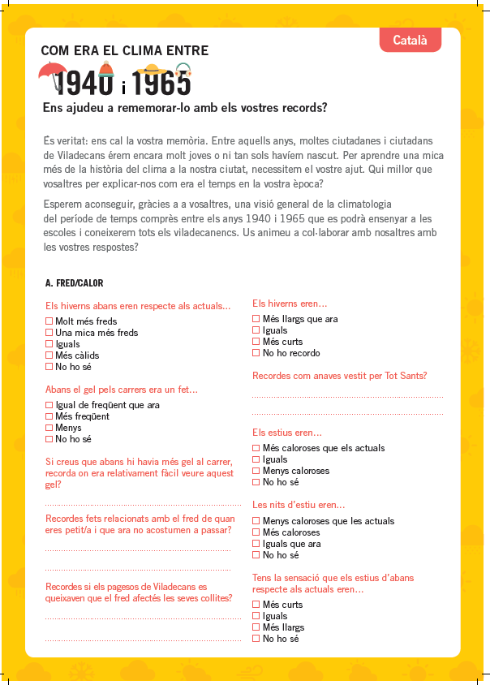
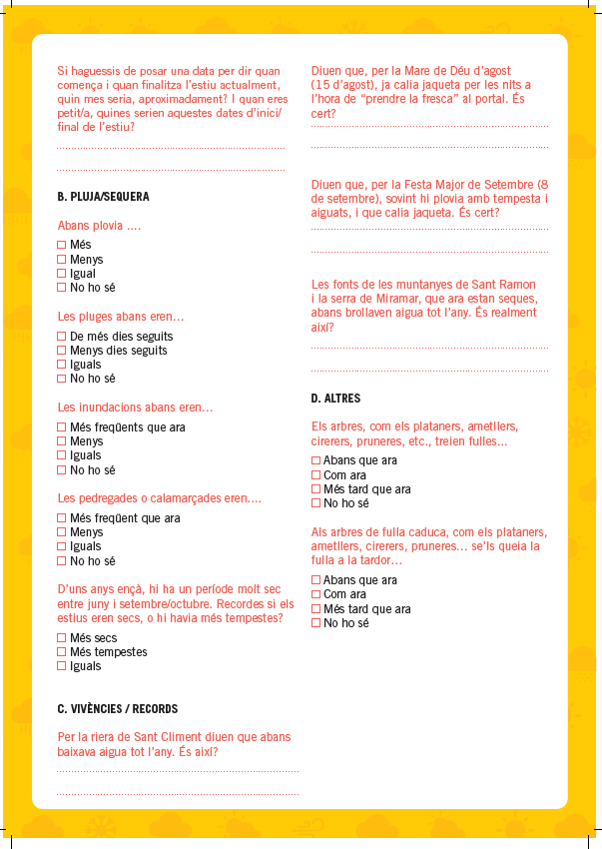
https://www.youtube.com/watch?v=oDQQ_2V7ntA
A climatic survey has performed for all the rest Testimonies
(in all elderly people's home)
Goal is to get objective data from subjective memories
A educational project is designed (in progress) for the last cycle in the elementary school (8-12 years old) linked to the survey and the video.

Slide 11
Some results (I): Short comparative of comments
Testimonie (> 75 year old) | Children (12 years old)
Puddles were freeze. We played with the ice in the school's playground. | Puddles never freeze. We never see ice in the street.
Local party (September 8th) storms and weather becomes colder during the nights. | Warm nights in the local party. Local party is in summer!
from mid October (12th, national party) we wore stockings and long skirt | We are wearing short trousers and t-shirts until end October, and sometimes even November.
November 1st, starts to work the fireplace. We released the coats. Winter starts. | We celebrate the chestnut party on the beach. It's not cold.
Snowfall was more common than now | We never seen snowfall in the city (maybe 1 time in the last 10 years)

Slide 12
Some results (II): Short comments from Testimonies
When I was child … | Nowadays…
In the main stream water flow to the sea all seasons. | No water running in the stream (only when heavy rain)
We know several water sources in the mountain and in the city. | Water sources are dry. We don’t know any water source in the local mountain and the city.
Artichoke crops often freeze. | Artichoke crops has been expanded. Freezing free area (1 day of weak freeze last 2 years).
It was common to have several consecutive days by raining. | Rain is short, concentrate in a short period. No consecutive days raining.
Summer was shorter and colder than now. | Weather is crazy. It has changed.

Slide 13
Conclusions
A different approach about the climate change has been achieved by recovering memories of old people.
People aged higher than 75 are the last generation before the great change in the weather tendency. This is (maybe) the last opportunity to get and record their experiences and memories about the weather before the great change in the climate tendency.
Their comments, memories and experiences are valuable non-instrumental data, useful as a complementary scientific data.
Additionally, real testimonies can help younger people to be aware about the real climate change.

Slide 14
Thank you for your attention
Jordi.mazon@upc.edu

